Slide 1
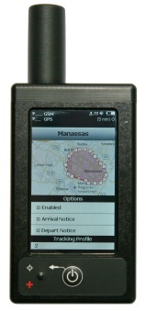
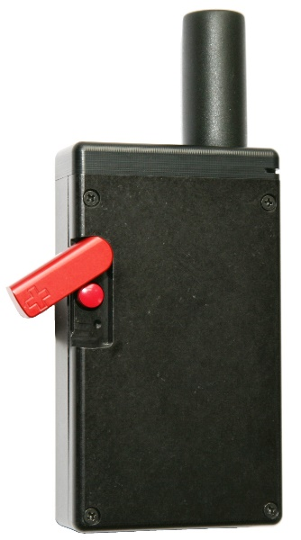
DEVICE DESCRIPTION: The SHOUT tw comprises a touchscreen, a Power/Back button, an LED Status Display, a guarded Emergency button, and a USB port.
IMPORTANT: The SHOUT tw must have a full view of the sky during transmission.
Iridium Antenna
GPS Antenna (embedded)
Device Status
Rotating Guard
Touchscreen
USB Micro-B Interface
Emergency Button
LED Status Display
Power/Back Button

Slide 2
DEVICE STATUS SYMBOLS: Device status symbols are displayed along the top three lines of all screens. Some symbols do not appear until an event is initiated, such as sending or receiving a message.
Battery Indicator: battery is being charged
Audio alert is on
One or more unread messages are in the Inbox
One or more messages are in the Outbox ready to be sent or one or more messages in queue failed to send
Iridium Signal
GPS Signal
Date
Tracking on when the symbol is bright white. The symbol turns dimmed gray when tracking is off
Geofences: On - symbol is bright white Off - symbol is dimmed
Mailbox Check is on when the symbol is bright white. The symbol turns dimmed gray when Mbox Check is off. It is only available when the Iridium link is enabled. It checks for any pending messages at the Iridium Gateway.

Slide 3
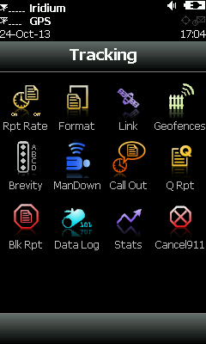
911 EMERGENCY
Activate 911 Emergency: Press the 911 Emergency button on the device. The Status bar turns red and the status LED turns solid green. An alert is immediately sent to a designated monitoring center(s).
Cancel 911 Emergency: Navigate to the Tracking Menu and select Cancel 911 . NOTE: The Cancellation message is queued in the Outbox to be transmitted, and the Emergency mode ends immediately. Turning the SHOUT ts off does not cancel the Emergency mode. You MUST select the Cancel 911 option to cancel the emergency.

Slide 4
POWER ON/OFF DEVICE
Press the Power button for two seconds to turn on device.
Press the Power button for two seconds to turn off device. A Power-down Screen appears.
Press Turn Off to turn off the SHOUT tw.
Press Lock to go back to the power-up screen, or press Cancel to return to the previous screen
.

Slide 5
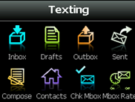
MESSAGES
Check Messages
Select Texting from the Home screen.
Select Inbox from the Texting screen.
Read messages have a white opened envelope symbol next to them.
Unread messages have a green closed envelope symbol.
A closed envelope symbol appears at the top of the screen when an unread message(s) is in the Inbox.
Compose Message
Select Texting from the Home screen.
Select Compose from the Texting screen .
NOTE: From the Compose menu, you can enter, edit, and send canned messages, free-text messages, or a combination of canned and free-text messages to: NOC server, predefined list of email addresses, and/or any email addresses entered via the keyboards.
Sent Messages
Select Texting from the Home screen, then select Sent from the Texting screen . This displays a list of messages that were successfully sent to the NOC. A message can be resent, forwarded, or deleted.

Slide 6
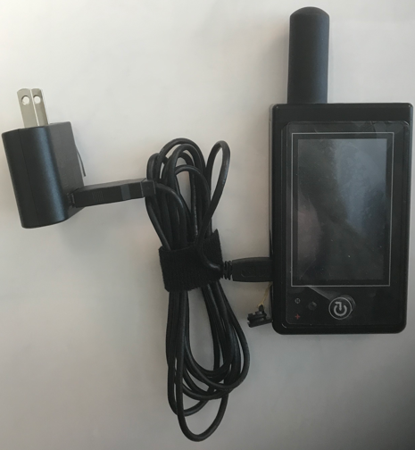
CHARGING BATTERY
Fully charge the SHOUT tw before use. The SHOUT tw must be kept in environments between 0°C (32°F) and 45°C (113°F) when charging.
The SHOUT tw can be charged with the supplied AC wall adapter or connect to a standard USB device.
NOTE: the battery symbol turns red when the remaining power is less than 20%. A warning message appears when the remaining power is less than 10%.
WARNING!
All batteries can cause property damage, injury, or burns if a conductive material, such as jewelry or keys, touches exposed terminals. The material may complete an electrical circuit and become extremely hot. To protect against such unwanted current drain, exercise care in handling any charged battery, particularly when placing it inside your pocket, purse, or other container with metal objects.
Do not disassemble the SHOUT ts for battery replacement. Return it to NAL Research for services. Risk of explosion if battery is replaced with an incorrect type. Dispose of the batteries (ts) according to local, state, and federal regulations or laws.

